Slide 1
Ireland’s Perspective on Speeding The Government Road Safety Strategy (2021-2030)
Sam Waide
CEO of the Road Safety Authority
26/10/2022

Slide 3
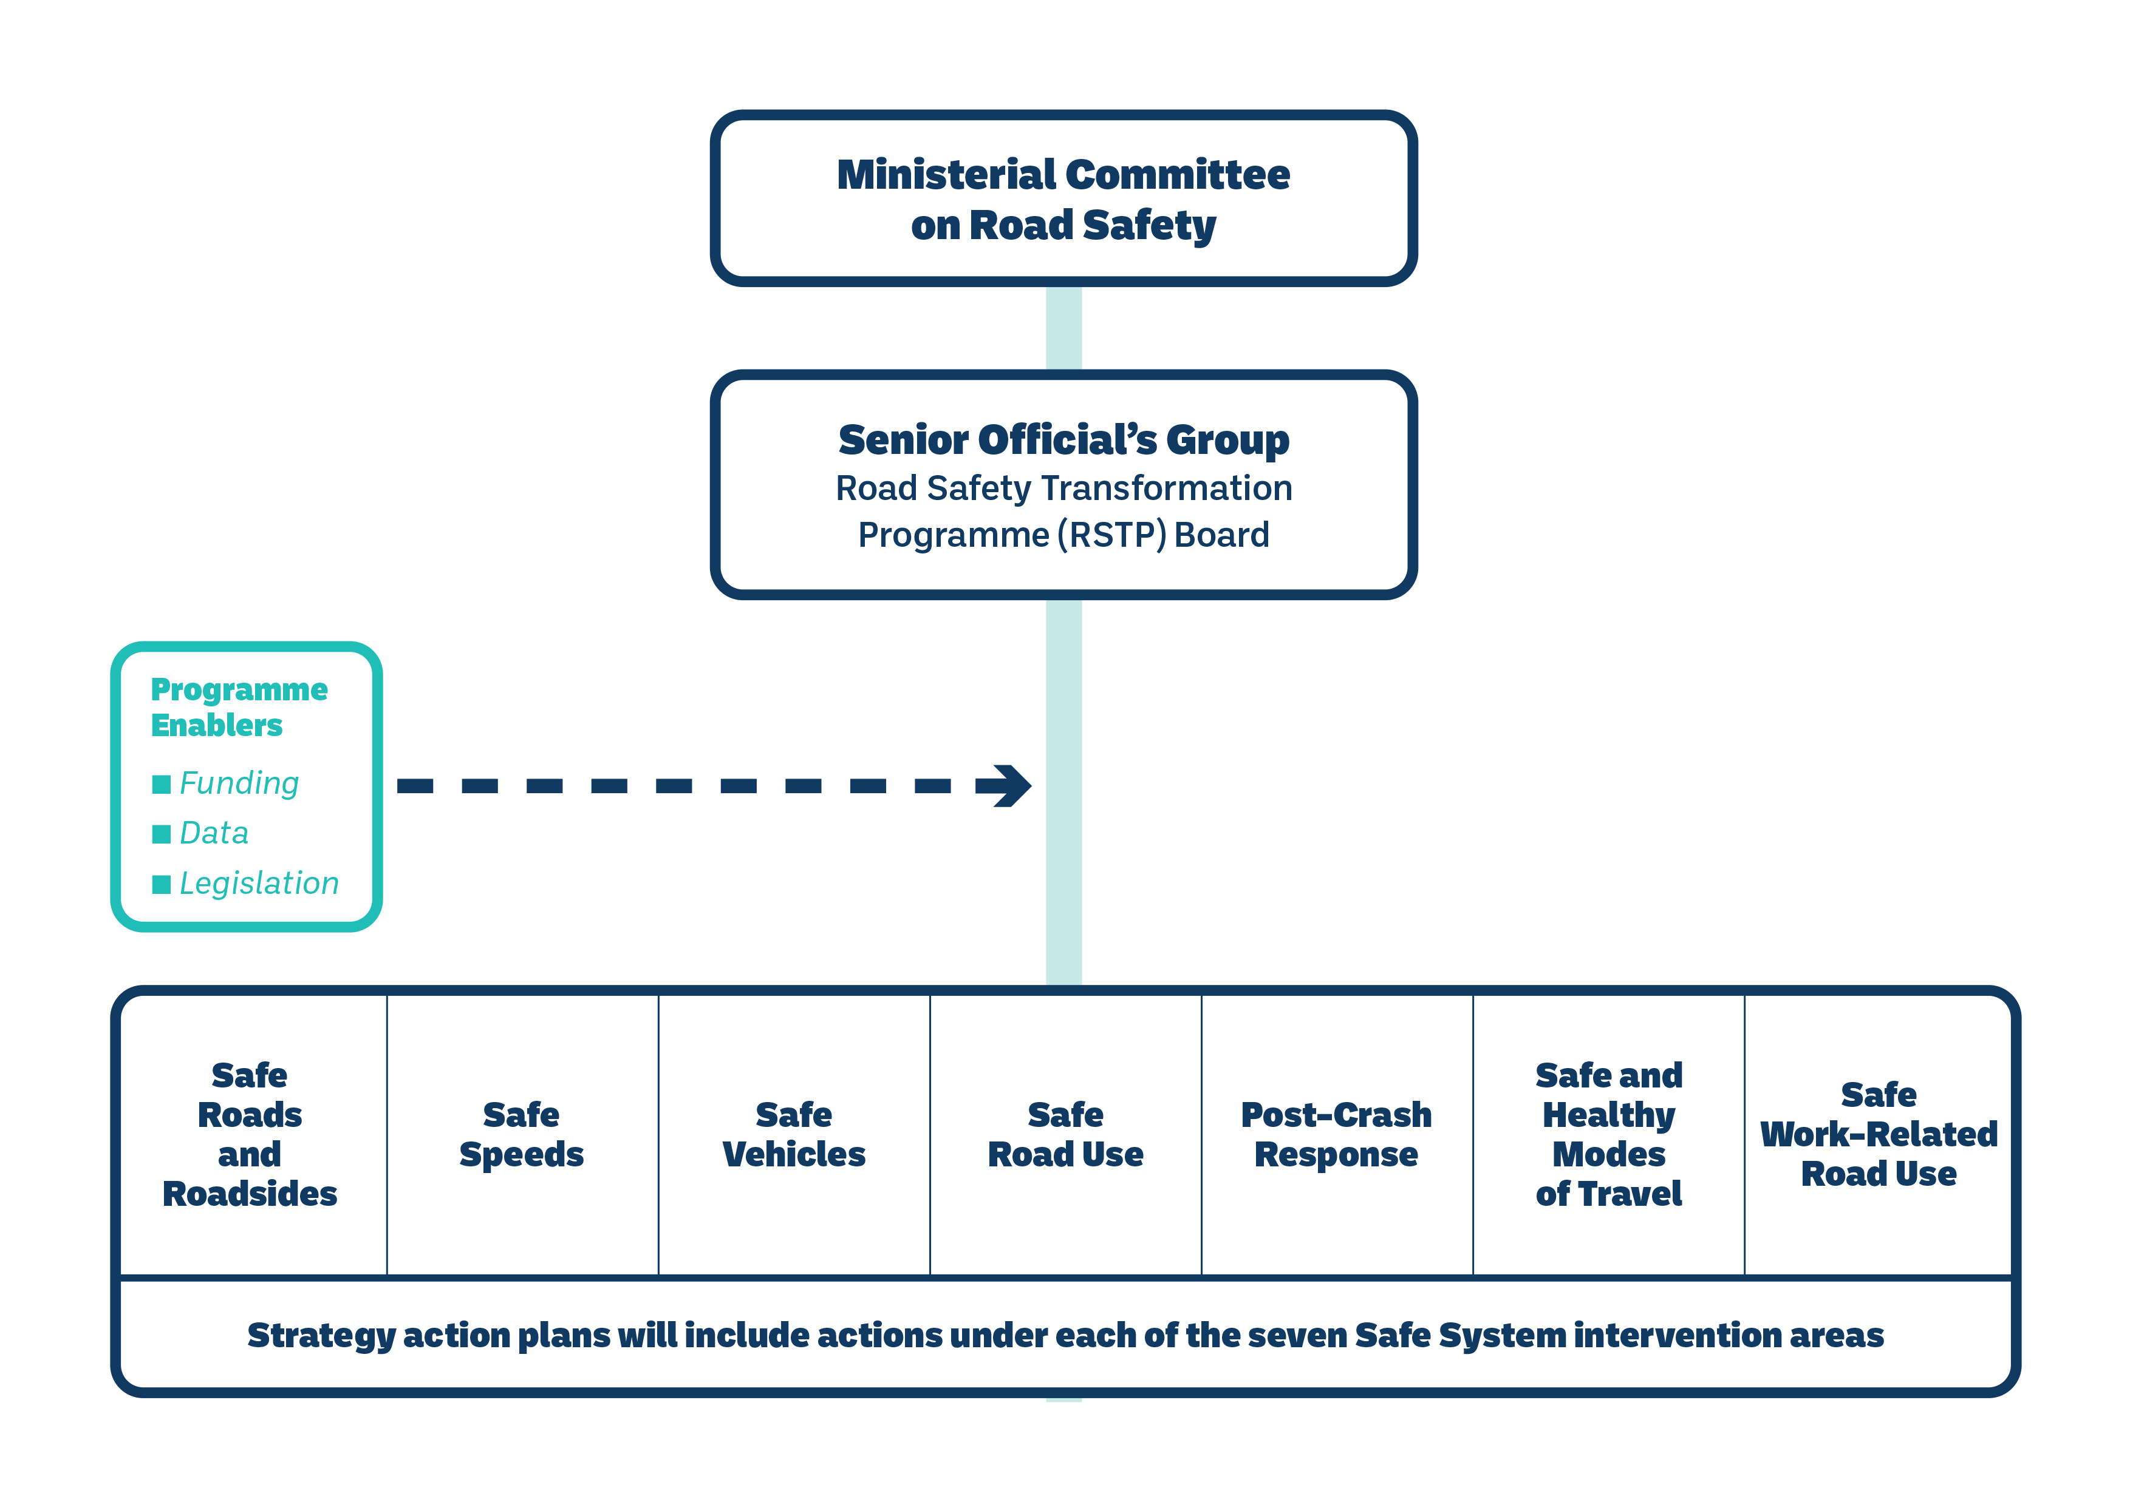
Road Safety Governance and Accountability
The RSA continues to work closely with key EU bodies and others, including:
EU Commission
EU High Level Group
EU Members
ETSC
ITF / OECD

Slide 4
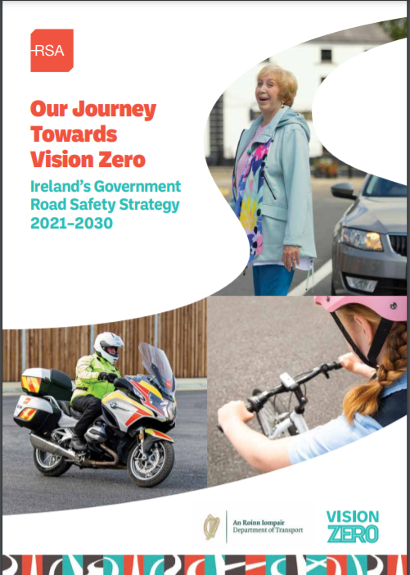
Ireland’s Road Safety Targets
2024
15% reduction in fatalities 10% reduction in serious injuries
2030
50% reduction in fatalities 50% reduction in serious injuries
2050
Vision Zero, zero deaths & zero serious injuries

Slide 5
Safe System Priority Intervention Areas
To reduce speeds to safe, appropriate levels for the roads being used, and the road users using them.

Slide 6
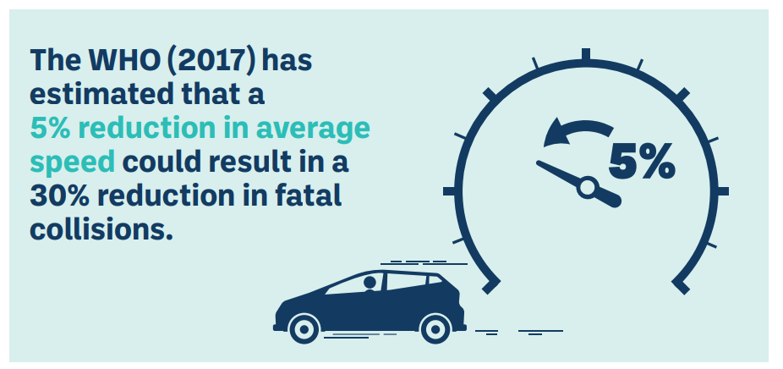
The importance of Safe Speeds
Driving at excessive speed increases the likelihood of a collision occurring, and the severity of injury sustained should a collision occur.
It has been estimated that 10-15% of all collisions and 30% of fatal collisions are the result of speeding or inappropriate speed (European Road Safety Observatory, 2020).

Slide 7
Safe Speeds: High-impact Actions
Phase 1 Action Plan (2021-2024)
# | Action | Lead Dept or Agency | Due Date | Support Dept or Agency
6 | Establish a working group to examine and review the framework for the setting of speed limits. As part of this review there will be a specific consideration of the introduction of a 30kph default speed limit in urban areas. | DoT, RSA | Q4 2022 | AGS, TII, CCMA / LAs, NTA
7 | Establish a task force to share data and information on speeding, make recommendations and urgently implement any further measures identified to reverse the trend of non-compliance. | RSA | Q4 2022 | DoT, AGS, TII, CCMA / LAs
8 | Expand speed management measures on National, Regional and Local roads using Periodic Speed Limits at schools, Vehicle Activated Signs and Average Speed Cameras in collaboration with An Garda Síochána at appropriate high-risk locations. | DoT, TII, NTA | Q4 2024 | CCMA / LAs, AGS, RSA
9 | Review the operation of the mobile safety camera system to maximise its effectiveness in detecting road traffic offences. | AGS | Annual | RSA, CCMA / LAs
10 | Deliver public education on inappropriate and excessive speeding in conjunction with An Garda Síochána to improve speed compliance on all roads with a particular emphasis on regional roads and in urban areas for the protection of vulnerable road users. | RSA | Annual | AGS, TII

Slide 8
Thank you

